Slide 1
Update on Fiscal Sustainability
15 July 2025

Slide 2
Next steps on expenditure

Slide 3
Intention of updated work
Additional work
Focus on Government Expenditure in order to:
Identifying fastest growing spending areas and projections into the future.
Identify good fiscal indicators and targets.
Provide case studies on short termism.
These slides reflect our approach to operationalising the first two.
This is all initial working and subject to change.
Substantive data has been requested alongside additional modeling – making this a proof of concept.
Specifically, there are three measurement and communication areas where additional work could improve understanding of fiscal pressures.
Consolidation – taking an all of government approach to spending on functions
Benchmarking – international, demographic, and forecast based benchmarks
Tracking – how do we interpret, communicate, and update the above insights.

Slide 4
Summary
Additional work
Focus on Government Expenditure in order to:
Identifying fastest growing spending areas and projections into the future.
All broad functions have been growing over the past 20 years.
At a consolidated level spending on health has increased more rapidly than its share – and also appears to exceed certain benchmarks.
However, at a demographically adjusted level Federal health expenditure has been constrained.
Forthcoming disaggregated data will allow us to understand this further.
Identify good fiscal indicators and targets.
Aggregate targets at both the Federal and State level are accessed positively by the OECD. With relative expenditure, deficits, and debt low – and fiscal transparency high – further aggregate targets may be unnecessary.
Will provide a stock-take of fiscal targets that are commonly used, based on OECD characterisation.
Focus is on further work understanding which categories may be showing spending strain.

Slide 5
Insights from internal report

Slide 6
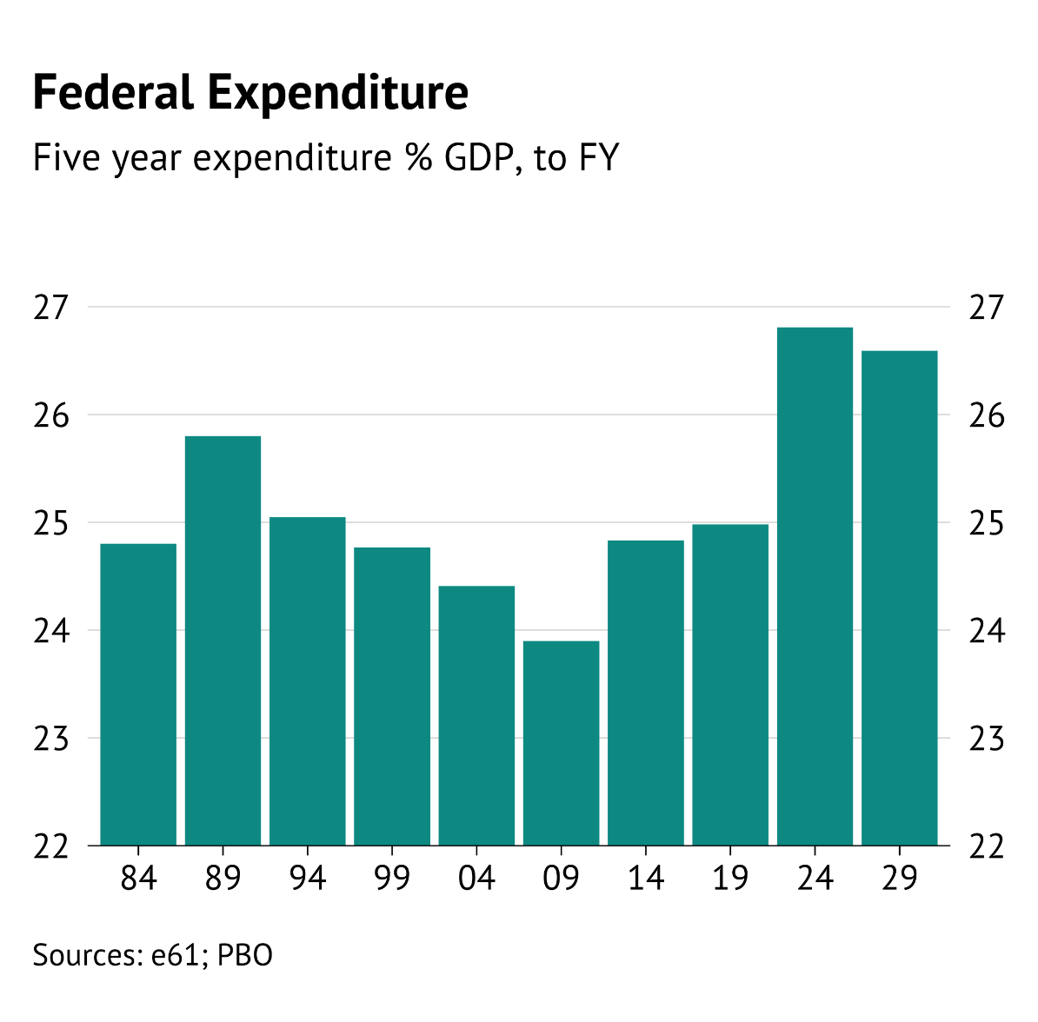
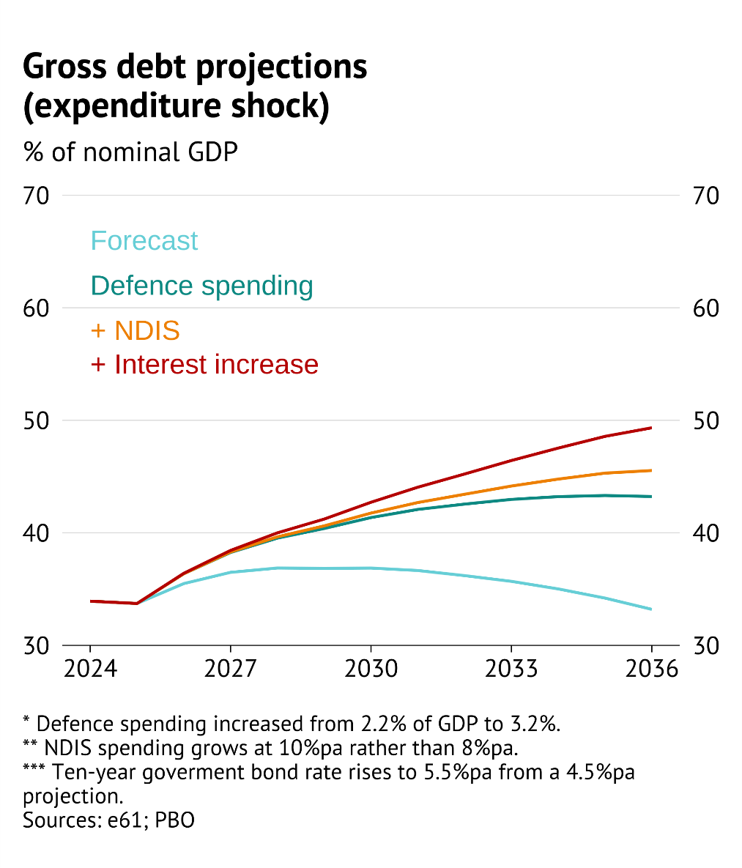
Internal report spending points
Internal reporting
High and risky

Slide 7
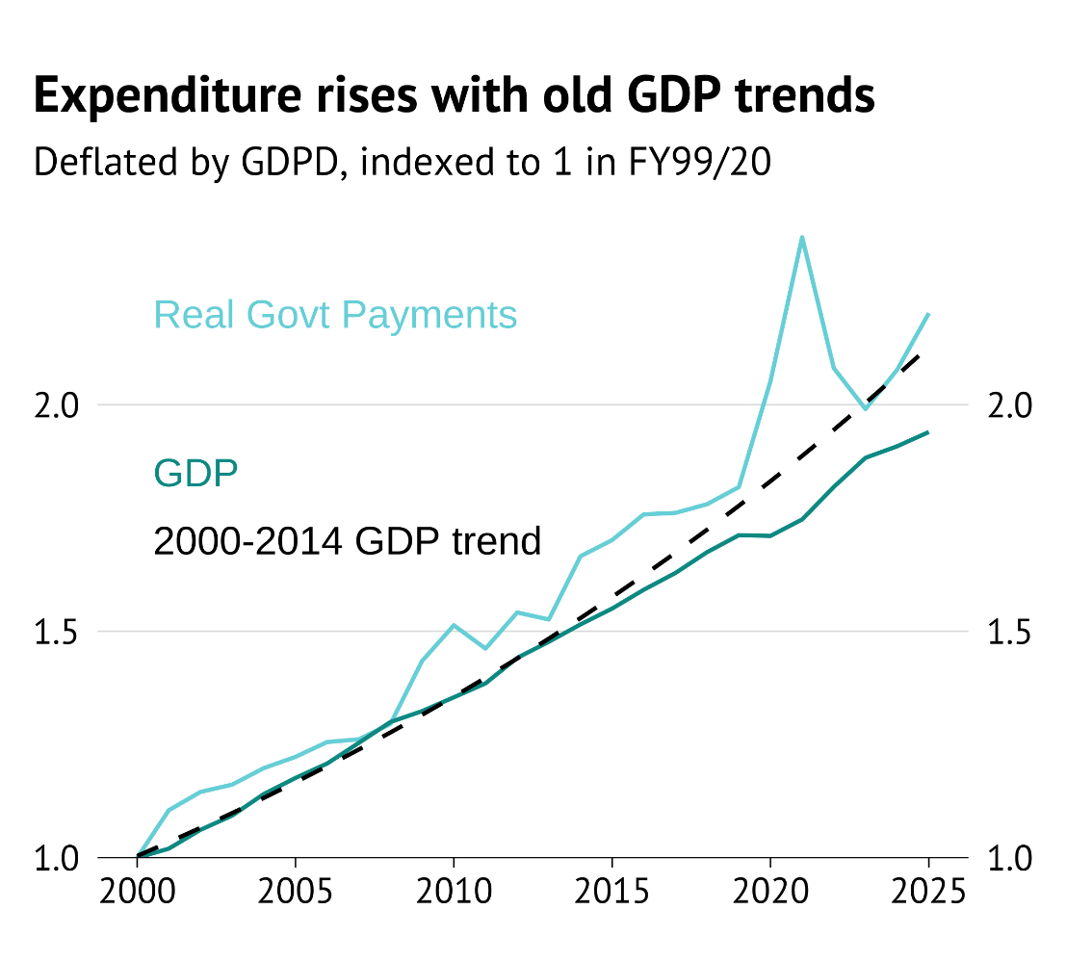
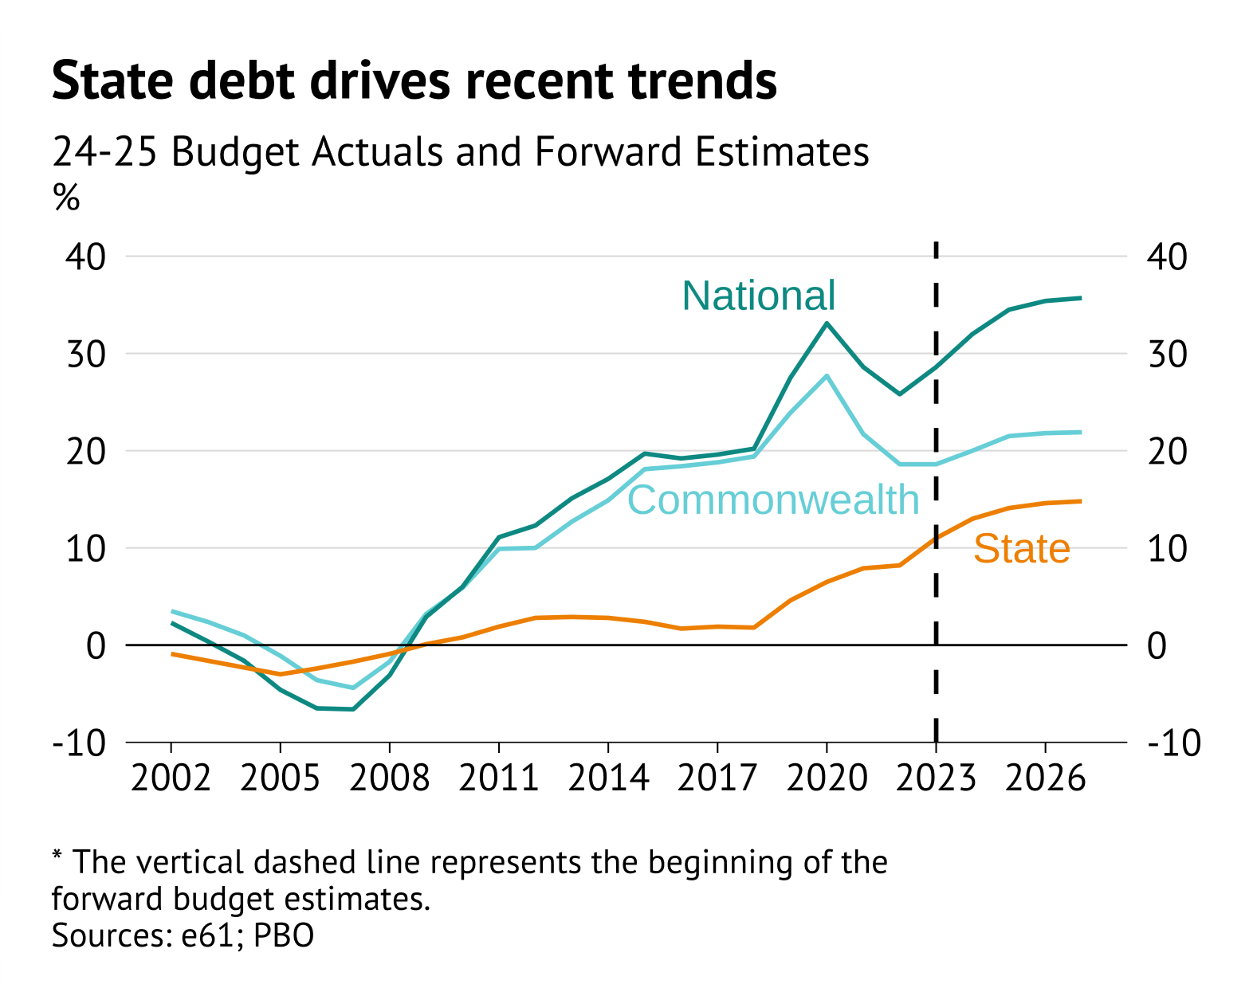
Internal report spending points
Internal reporting
Sticky expenditure growth and the importance of States

Slide 8
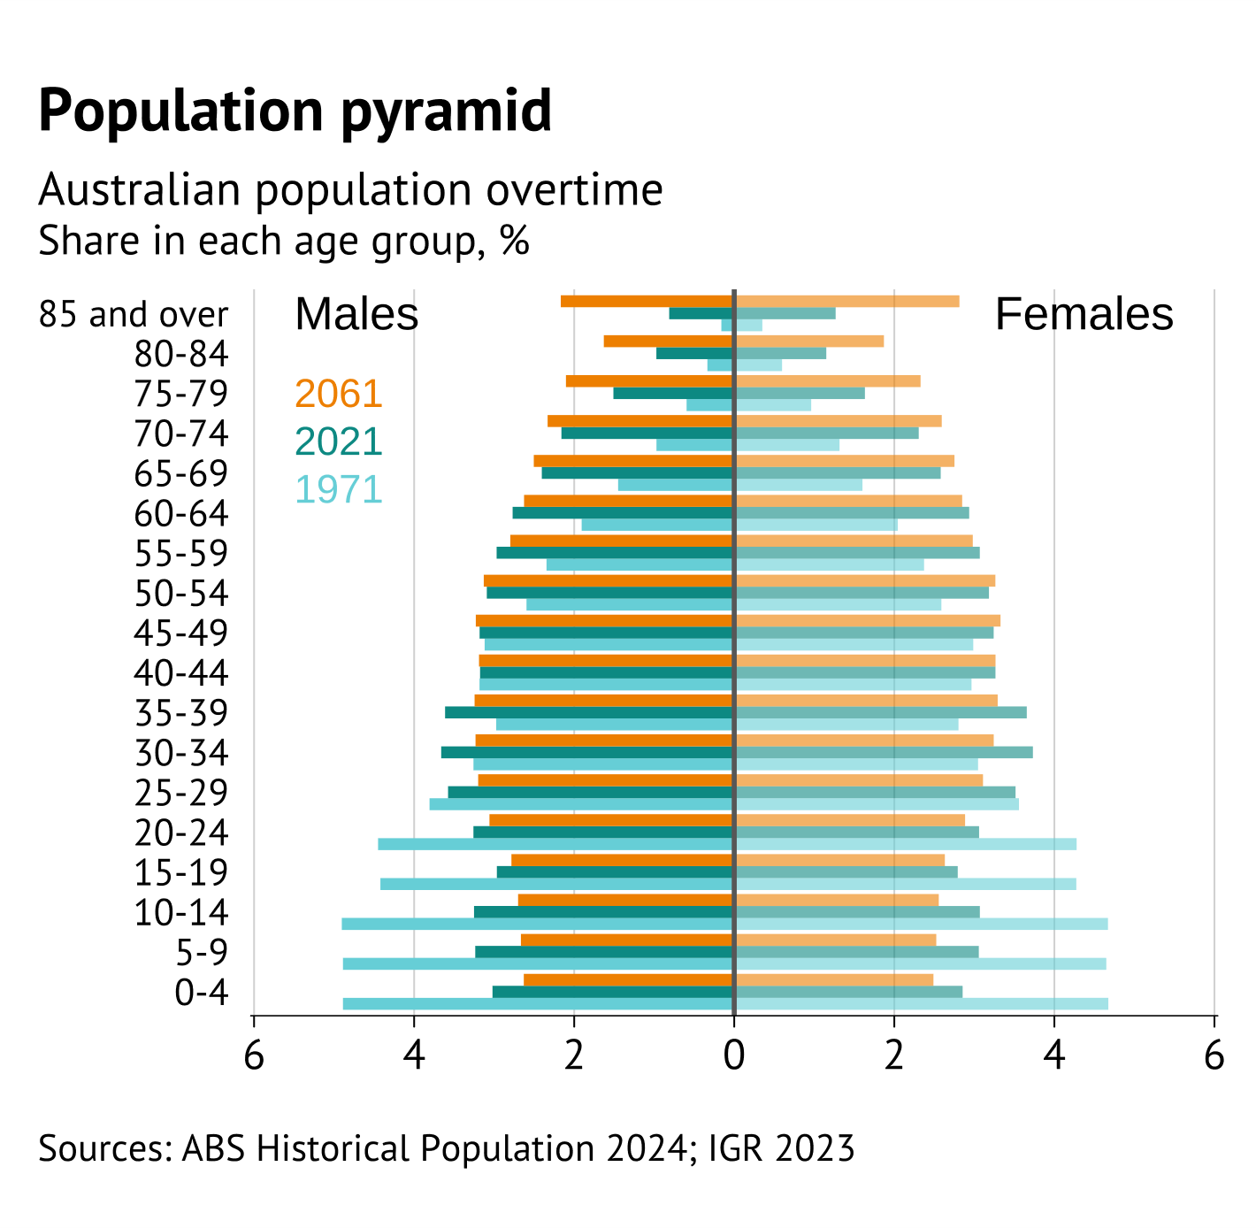
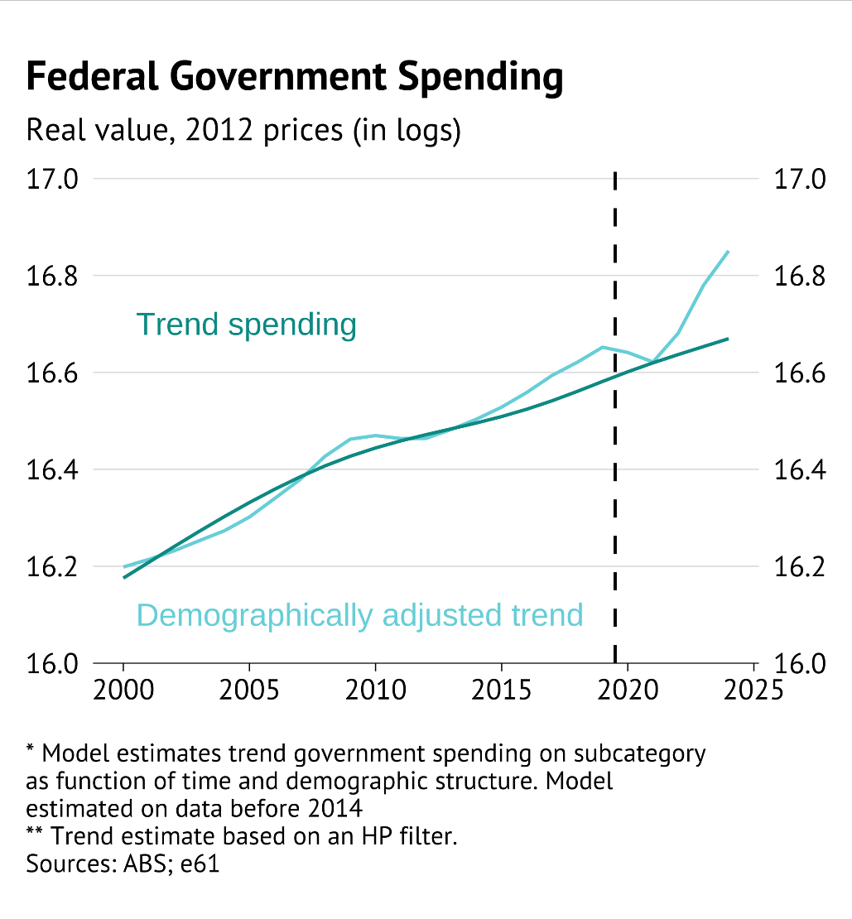
Internal report spending points
Internal reporting
The importance of ageing

Slide 9
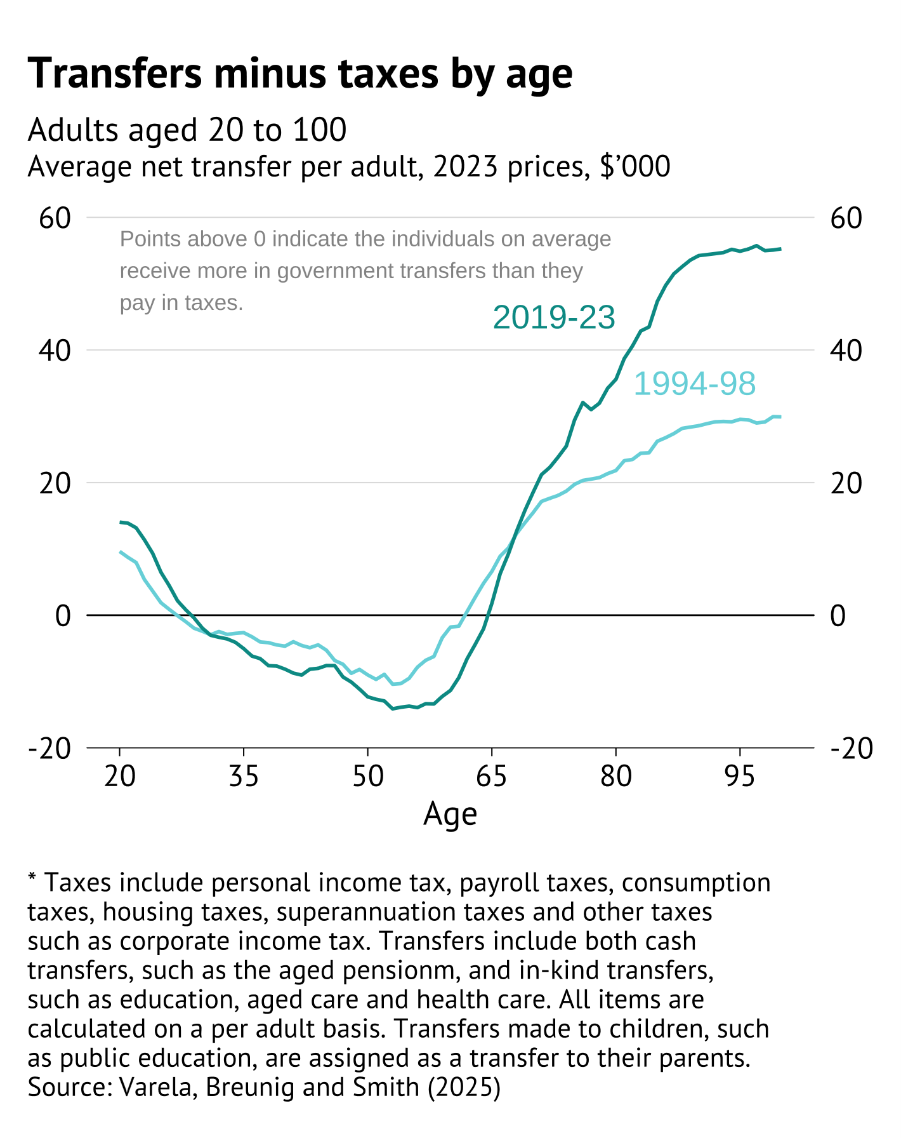
Internal report spending points
Internal reporting
The growing intergenerational transfer in spending systems

Slide 10
Describing spending growth

Slide 11
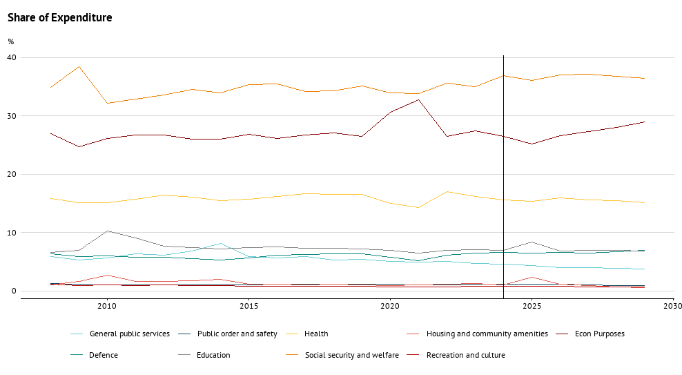
Growth in spending areas
Spending growth
At a Federal level Expenditure shares by function have been flat since the Global Financial Crisis.
Current data does not allow us to look at functions earlier, as many (especially Health) are defined differently.

Slide 12
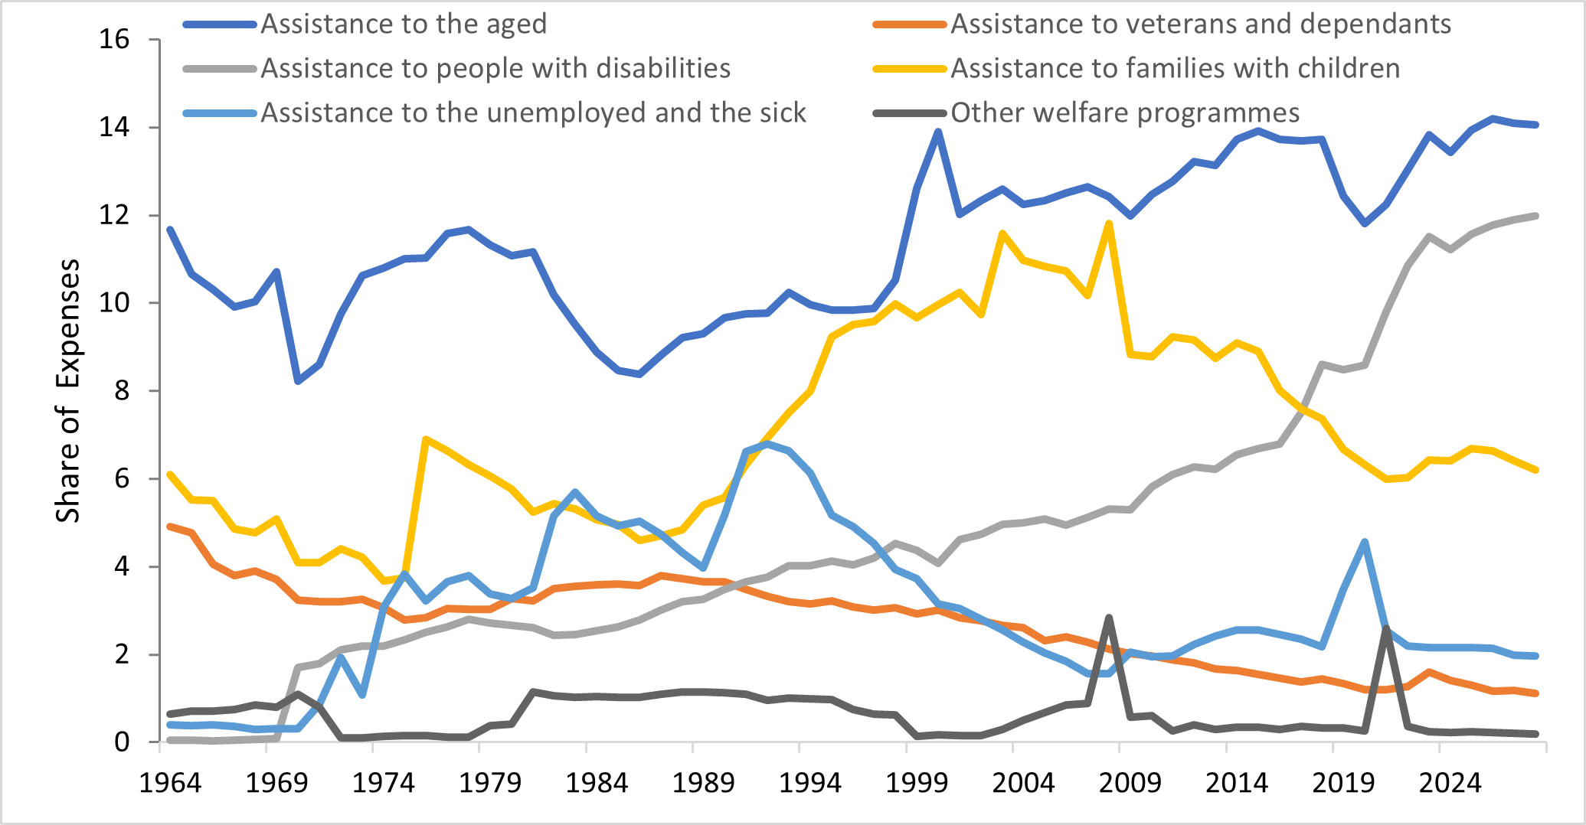
Growth in spending areas
Spending growth
However, the flat trend hides significant variability within categories (i.e. transfers – post McClure Review + NDIS)

Slide 13
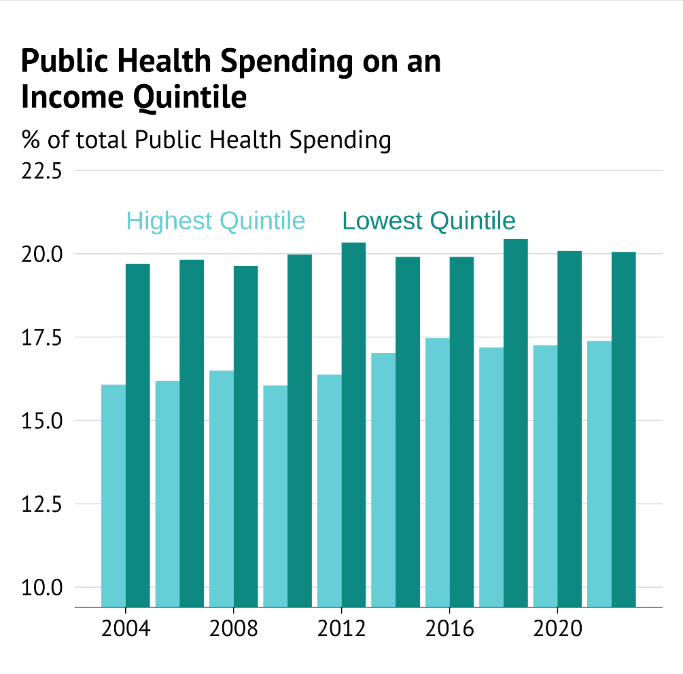
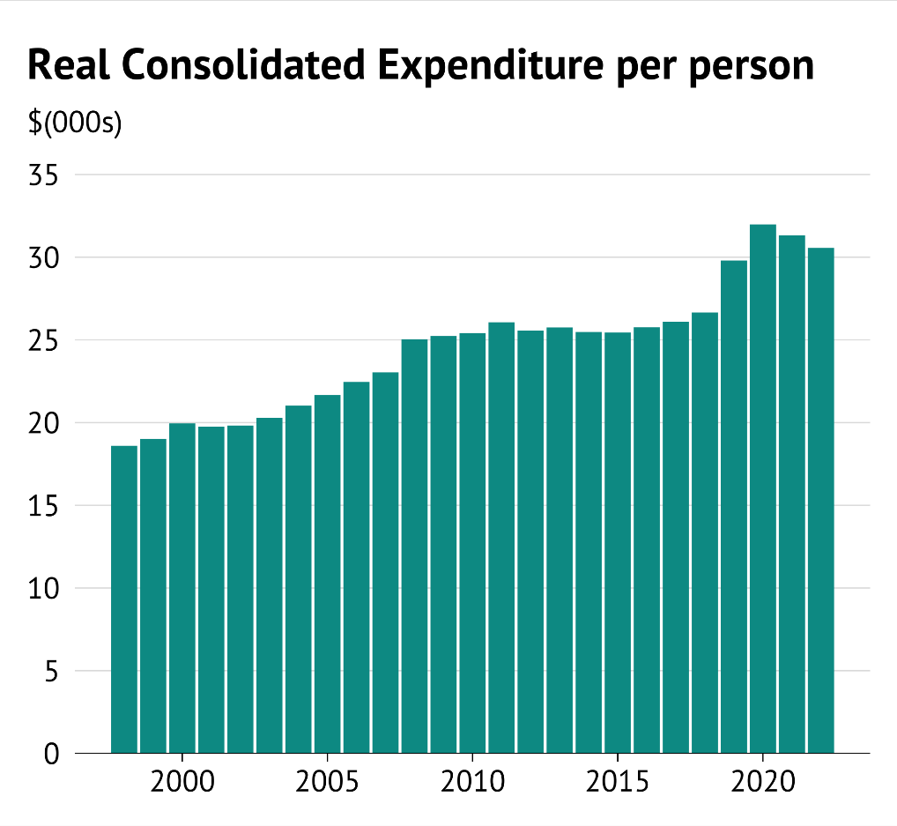
Growth in spending areas
Spending growth
Real spending has increased in recent shares, with a rising share going to higher income earners.
Spending per person
Health by household income

Slide 14
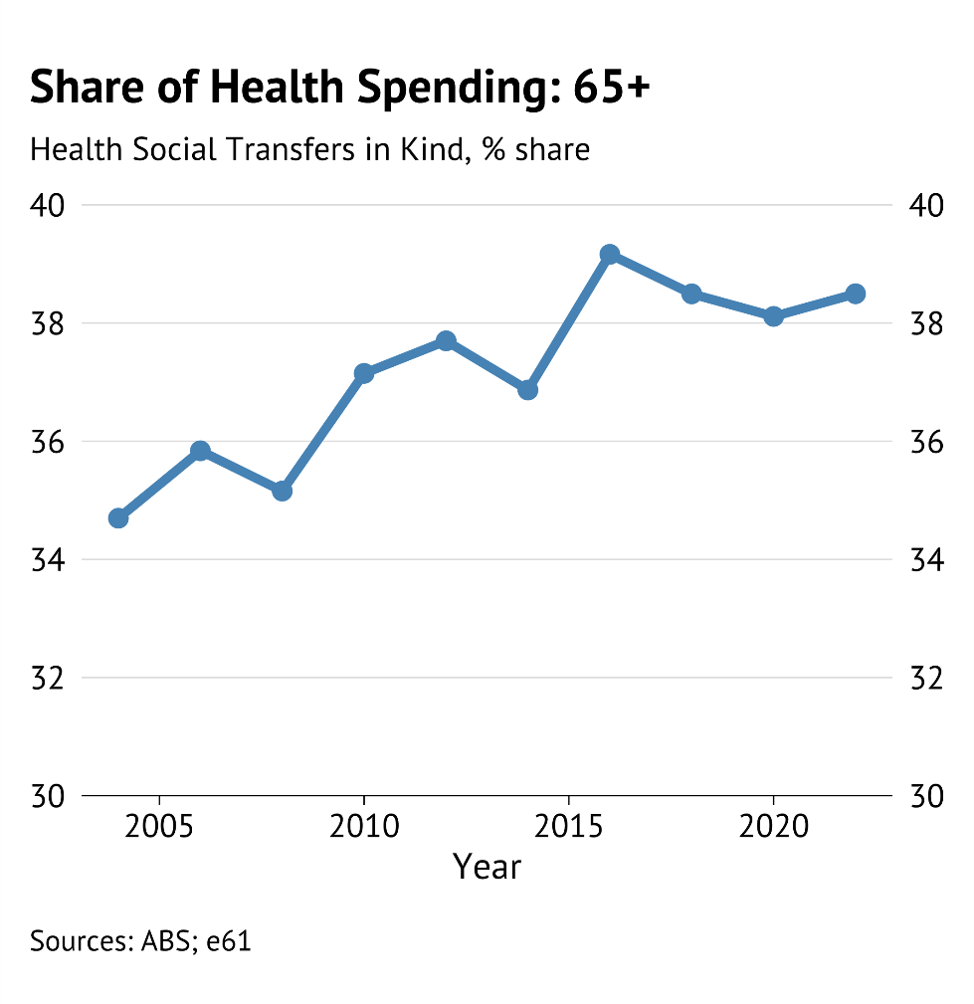
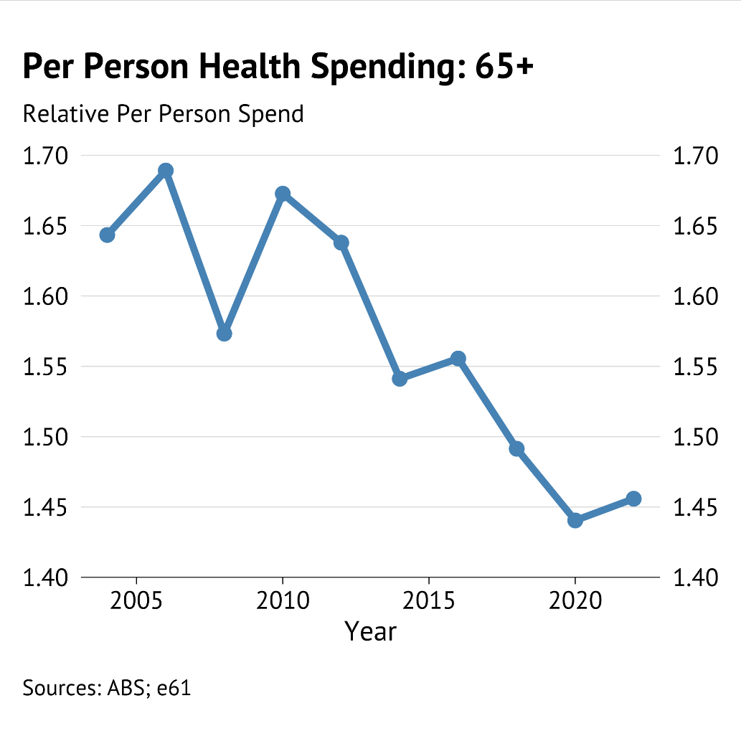
Growth in spending areas
Spending growth
Although 65+ account for rising health spending, this is due to an increase in the number of older people.

Slide 15
All of Government trends (Consolidation)

Slide 16
Consolidation
Consolidation
Consolidation treats Federal, State, and Local government accounts as one set of accounts.
Government Finance Statistics: Provides operating and balance sheet information on a whole of government basis. Two separate version (Australian National Audit Office, and ABS) – ANAO version match international standards of the time, ABS version is consistent over time.
COFOG-A: This provides consolidated government revenue and expenses excluding intra-governmental transactions. Two separate versions (OECD and ABS) – OECD allows for international comparisons, ABS provides more granular data for fee.

Slide 17
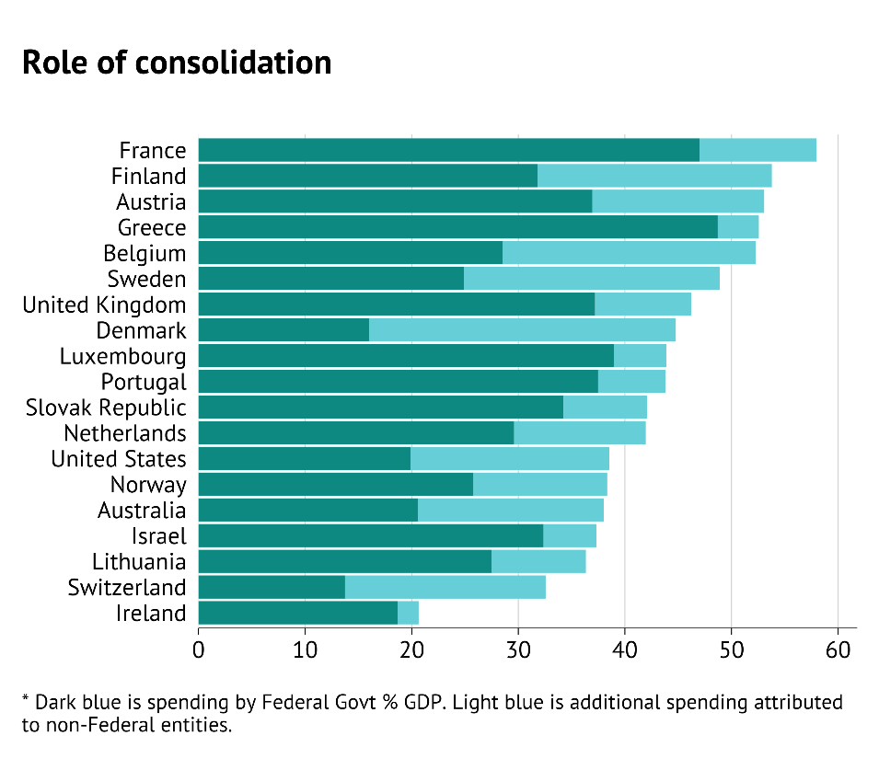
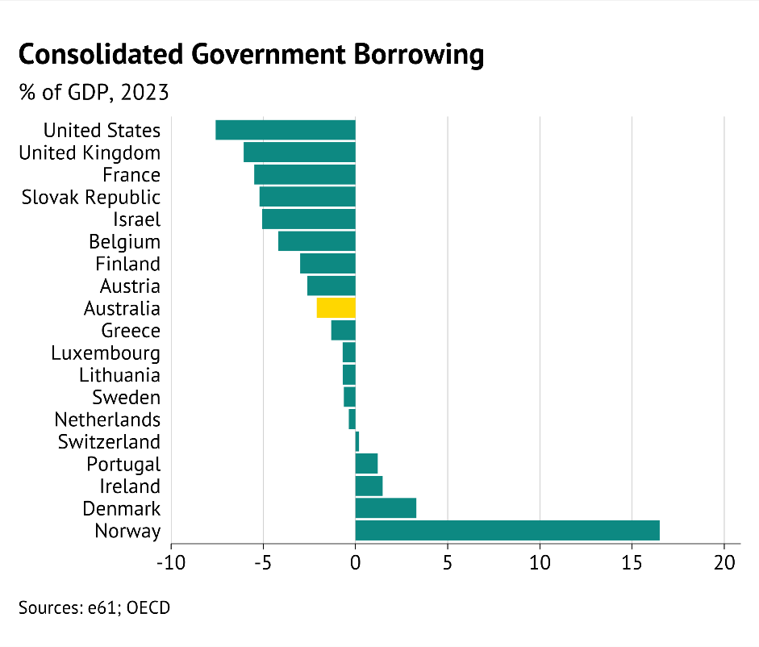
What does consolidation tell us
Consolidation
In General Spending
Consolidated government spending was 37% of GDP in 2021/22 (compared to 24.8% at the Federal level).
However, this is low internationally.
In deficit terms
Consolidation of borrowing implies that net debt will not decline over the next decade.
However, consolidated deficits are still low globally.

Slide 18
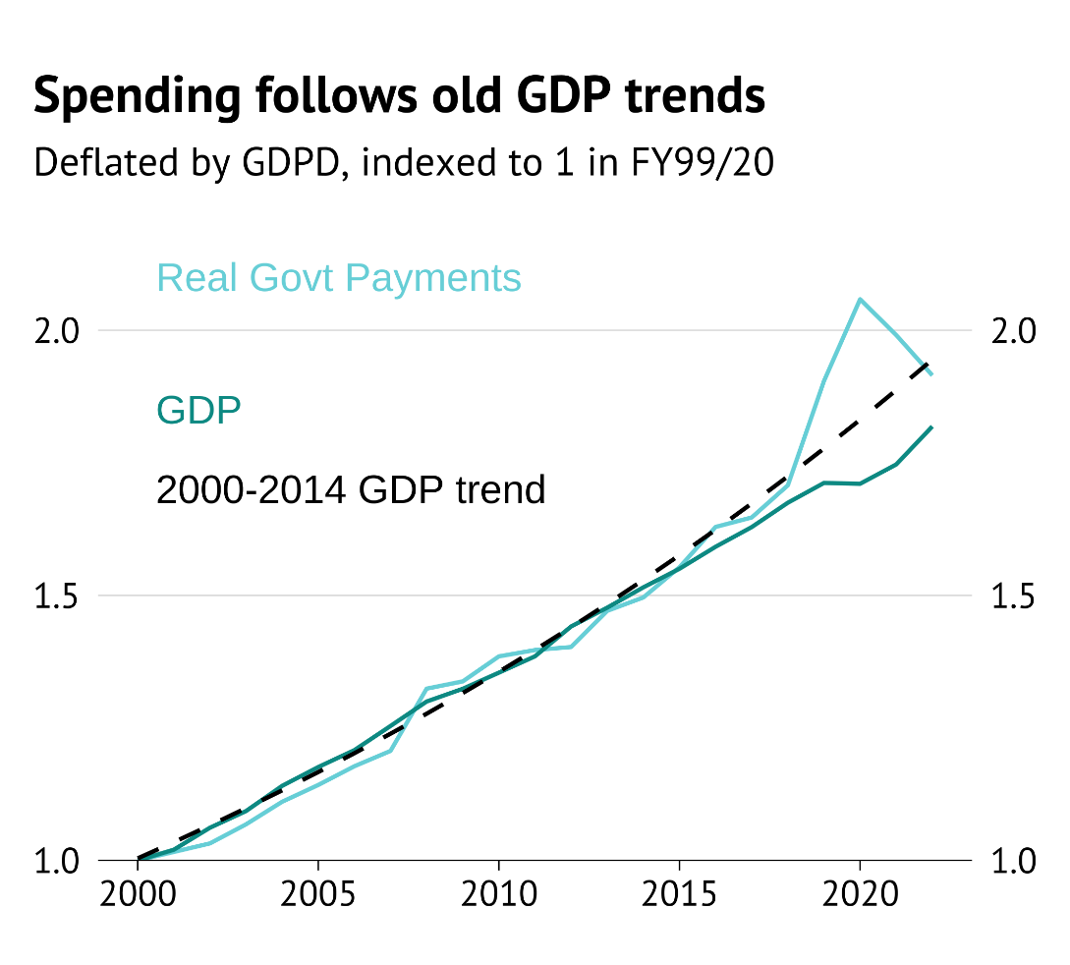
What does consolidation tell us
Consolidation
Stickiness of expenditures (short-termism) – stronger relationship than at Federal level.
Growing expenditure with all categories rising together may suggest Budgetary processes that are sticky.

Slide 19
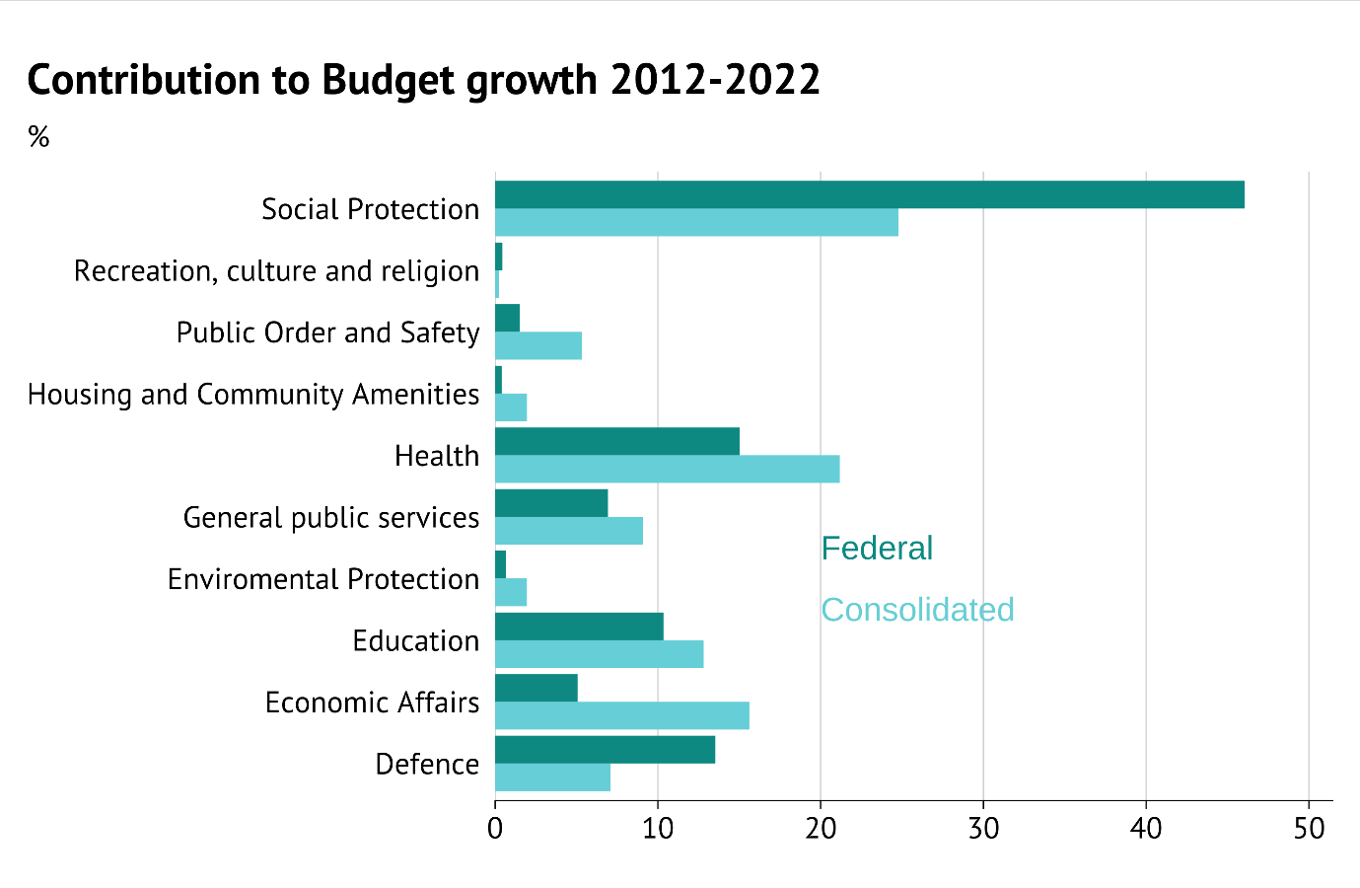
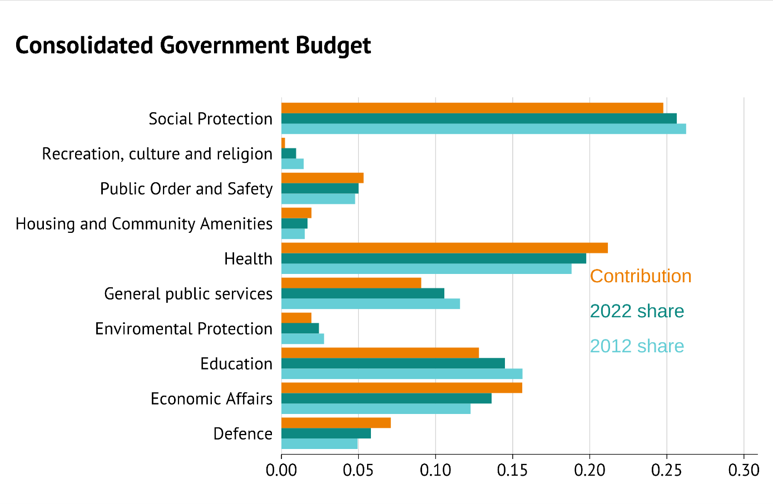
Where has consolidated spending growth occurred?
Consolidation

Slide 20
Where has consolidated spending growth occurred?
Consolidation

Slide 21
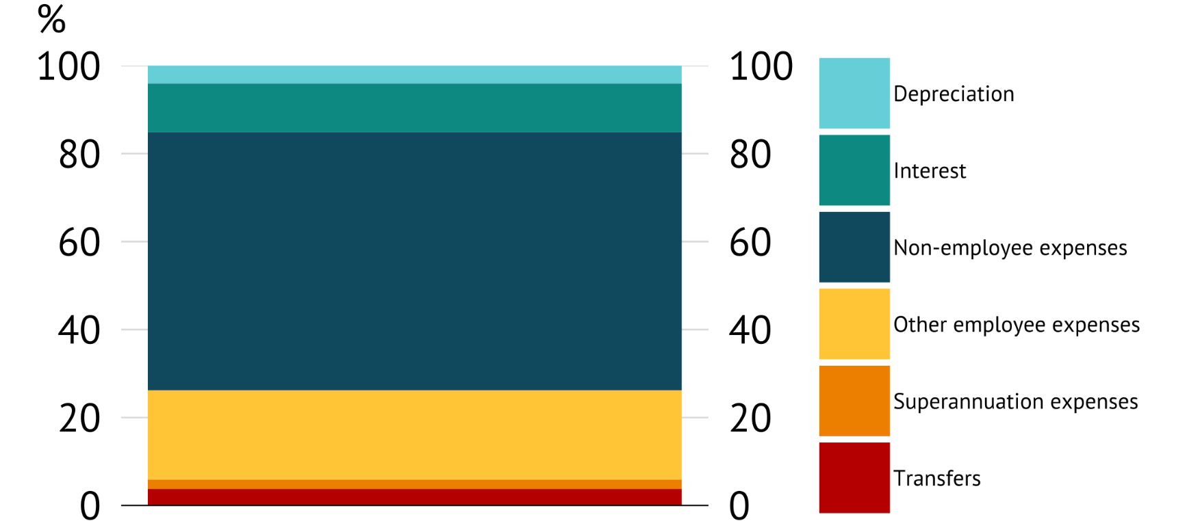
Where has consolidated spending growth occurred?
Consolidation
Share of real spending growth (2015-2024)
Since FY15, the largest contributor to real cost growth has been non-employee expenses.
59% of growth, from 39% of the total spend.
This reflects the large push to provide funds for private services – rather than direct service provision.

Slide 22
Benchmarking

Slide 23
Building a counterfactual
Benchmarking
When evaluating spending the key goal is that the marginal benefit of the use of public funds exceeds the cost of raising the revenue. This require project evaluation and subjectivity.
Benchmarking is a descriptive way to understand whether spending has varied from some status quo level – in order to motivate a deeper look into areas where spending has varied from these benchmarks.
Relative spending growth provided one type of benchmark. However, in a dynamic economy with population ageing, technological change, and growth the expected structure of spending may evolve. The goal is to generate benchmarks that capture demographic and economic trends.
Such benchmarks can also be used to project out to the future and allow for tracking of fiscal expenditures to highlight areas of concern.

Slide 24
Building a counterfactual - approaches
Benchmarking
International
OECD division COFOG data.
Synthetic control exercise to benchmark against “similar” countries.
Repeat the exercise for expenditure functions.
Adjusted expenditures
Disaggregated COFOG
Use demographic and economic factors to build benchmarks.
Sectors:
Health,
Education,
Public admin (ex defence),
Defence,
Other expenses
Include information on expense type (i.e. wages vs depreciation expenditure).
Below exercises are a proof of concept – we still need to do a lot of modelling work to ensure the results are robust.

Slide 25
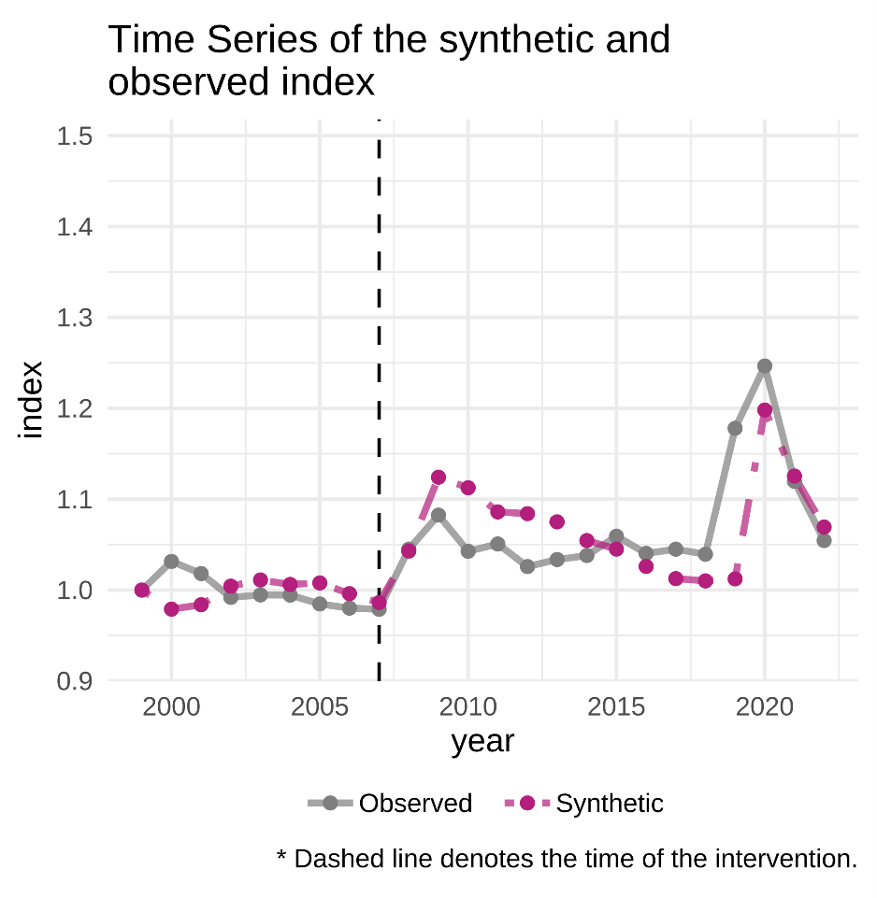
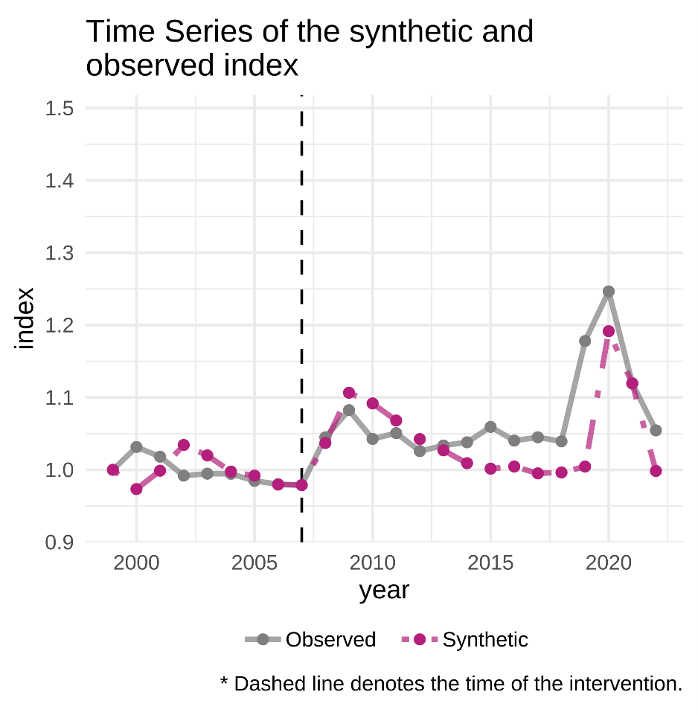
Building a counterfactual – international approach
Benchmarking
Exercise is to compare spending since the GFC to countries that were similar prior.
Similar spending countries
Similar spending and ageing countries

Slide 26
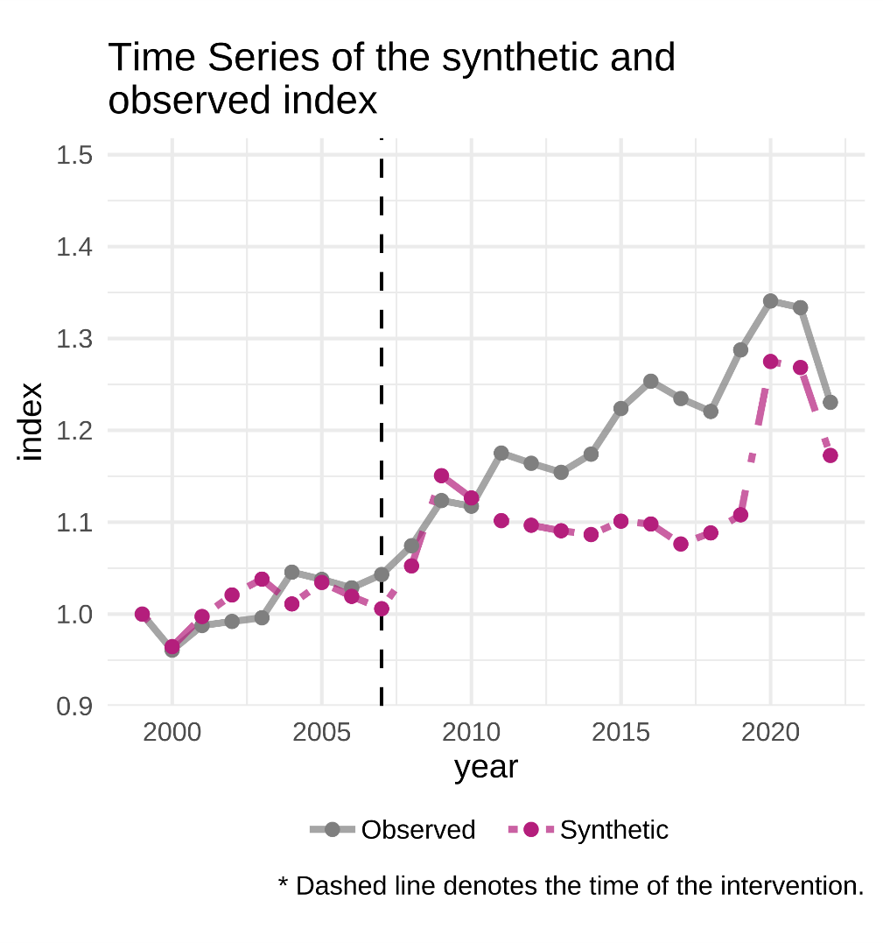
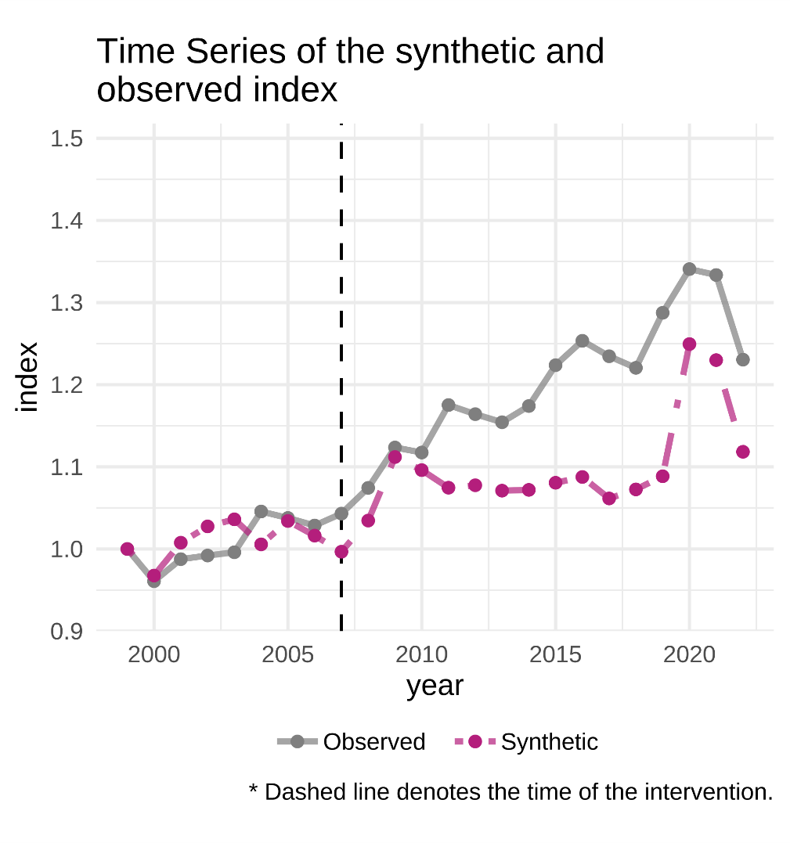
Building a counterfactual – international approach
Benchmarking
Health spending (to GDP)
Similar spending countries
Similar spending and ageing countries

Slide 27
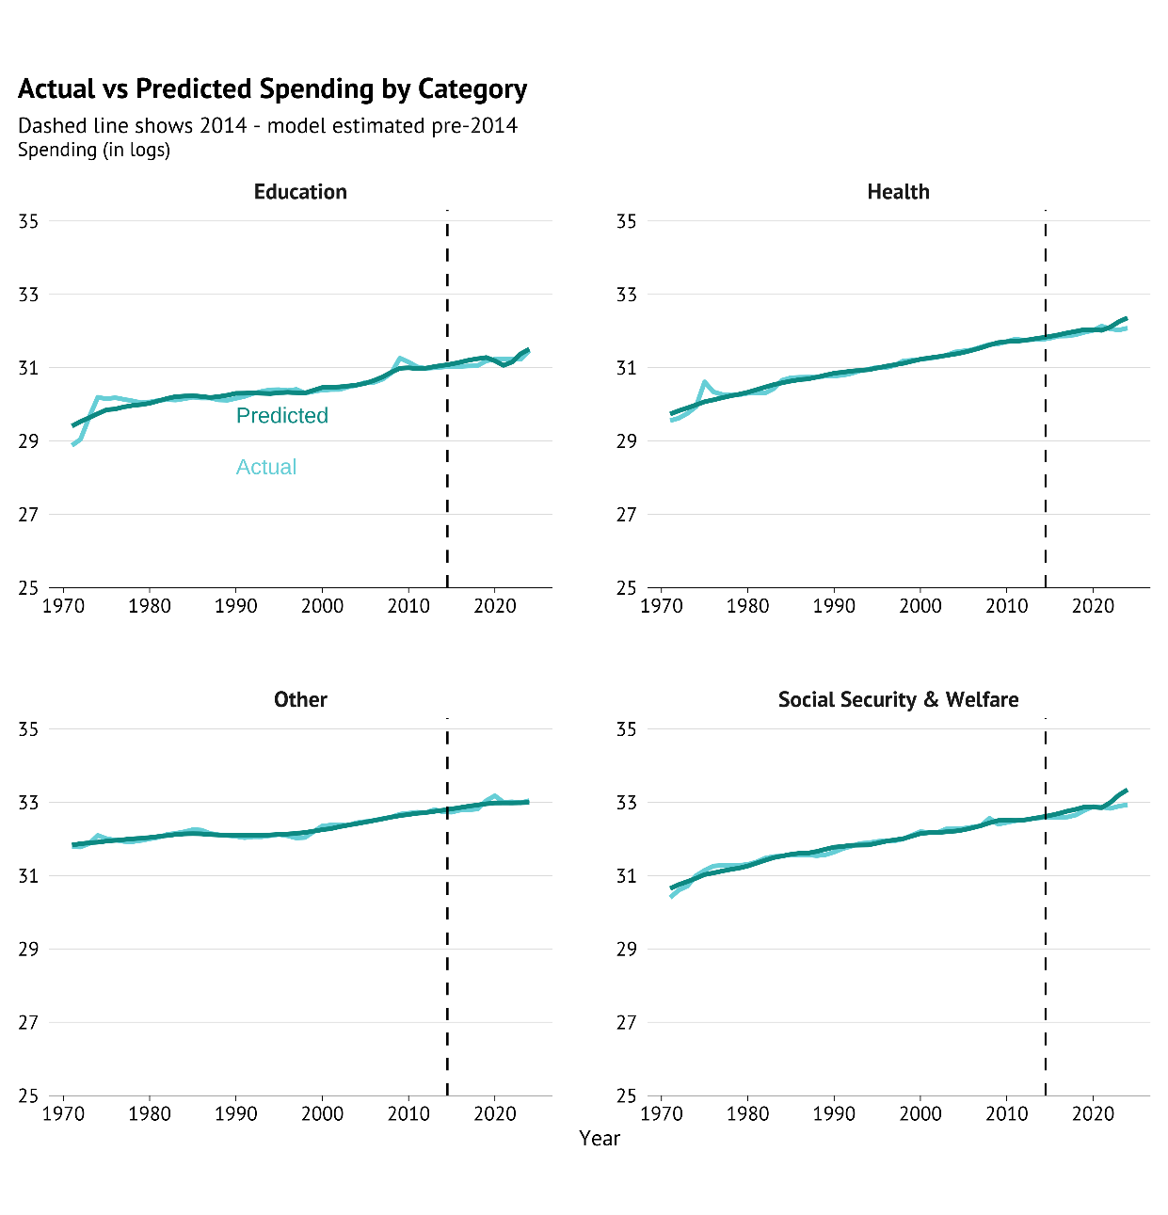
Building a counterfactual – adjusted expenditure approach
Benchmarking
Spending categories – Federal only. Estimated on population shares and time series properties.
Population ageing should have translated into a sharp lift in health and social welfare spending in the last two years.
But actual spending has been below these benchmarks.
Although this approach does not use information from other countries, we will be able to go to a more granular level of analysis – and use cluster analysis to consider groups of spending categories.

Slide 28
Building a counterfactual – alternative approaches
Benchmarking
Forecast comparisons
PBO provides historic forecasts of government expenditure across Budgets.
Helps to highlight cost overruns which may have changed historic choices if known.
There are some data difficulties around the attribution of payments, and changing categories – however, we will investigate the use of this data for an alternative benchmark.
Adjusted input expenditures
We are waiting on data to see the detail and quality of input cost information we receive.
The way that changes in demand are being met (through high use of labour or capital) influences the outlook for costs – and may be used to understand more about projected cost pressures.
We will be looking to add these types of benchmarks going forward.

